Slide 1
Inverse procedural Street Modelling: from interactive to automatic reconstruction
Phd Defense : Rémi Cura, 2016/09/12
Université Paris-Est
École Doctorale Mathématiques et Sciences et Technologies
de l'Information et de la Communication (MSTIC)
Jury:
Pr. Christian Heipke (IPI) R
Pr. Peter Van Oosterom (TUDelft) R Dr. Florent Lafarge (INRIA) E
Pr. Gilles Gesquière (LIRIS) E
Dr. Julien Perret (IGN) S
Dr. Nicolas Paparoditis (IGN) D
Dr. Kevin Lyvan (Thales) S
Notes:
Parler du context de la these :
Entreprise/labo
Projet terra mobilita

Slide 2
Foreword about this presentation
Work : 3 years
Presentation : 45 minutes
→ compression problem
Lossless
Only a summary, details in the articles/manuscript
High bandwidth: it’s going to be fast, apology

Slide 3
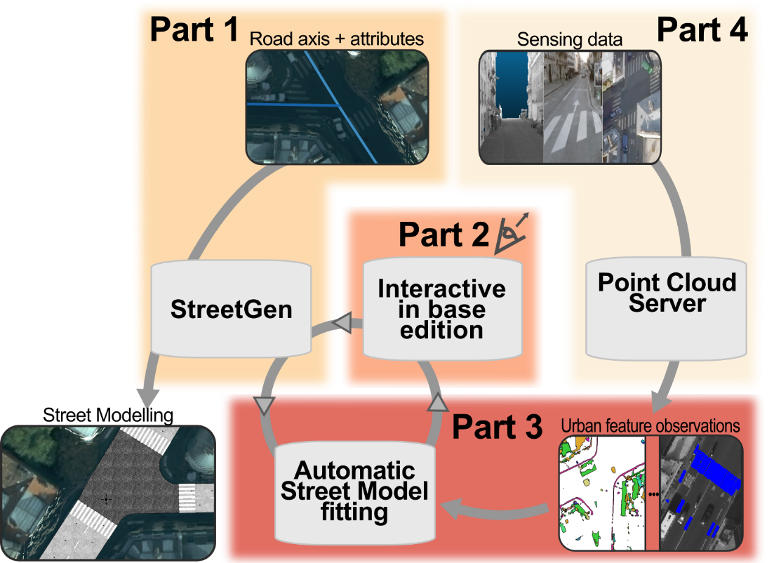
Abstract

Slide 4
PLAN
Introduction: Why model streets?
State of the art: How to model streets?
StreetGen :
Generating best guess streets
Editing streets (in-base)
Fitting the street model
Data for observation:
Point Cloud Server
Conclusion

Slide 5
Introduction
Why model streets?
Usages for street model

Slide 6
Introduction: Streets are important
im
Cities are important places
Many people live in it
World : 50% in urban area.
France : 80%
Concentrate people/power/usages/issues
Streets are important in cities
In Paris, streets area > building area
Streets = medium between people/occupations
im

Slide 7

Introduction: having a model is important
Why would we want an accurate, structured, up to date map of streets?
Mapping = maps are classical control/management tools
Map war for South America (Madrid, 1750)
Mapping = visualising: very helpful for human

Slide 8
Introduction
Why model streets?
Usages for street model

Slide 9
Introduction: usages for street model
Cities are actually carefully managed
Paris : 100’ of people, one dedicated engineer school
Requires data (precise, up to date)
Visualisation (map / 3D model)
Decision making
Consultation / communication
Simulation
Traffic / pollution / noise / parkings …
Analysis (past/present/planning)

Slide 10
Introduction: usages for city model
Street model ⊂ city model
Many usages for a city model
Urbanism
Transport
Environment
Security
Communication
…

Slide 11
State of the art
Modelling street, why is it hard?
Existing methods

Slide 12
State of the art: modelling street is hard
im
Even ‘regular’ streets are hard to model
Complex (even for human)
Traffic
Organised
Hard to sense
im

Slide 13
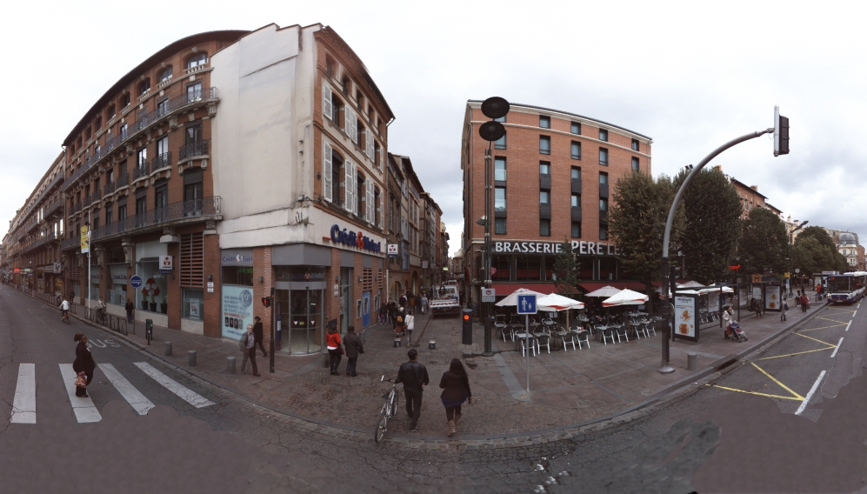
State of the art: modelling street is hard
complex / traffic / organisation/ sensing

Slide 14
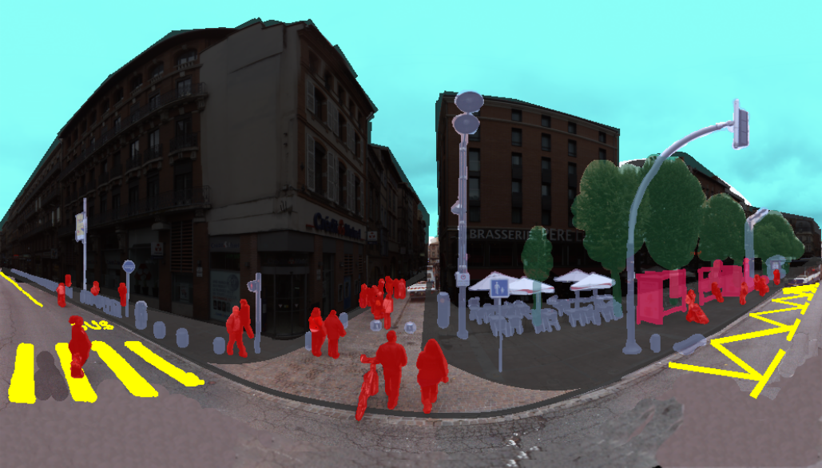
State of the art: modelling street is hard
complex / traffic / organisation/ sensing

Slide 15
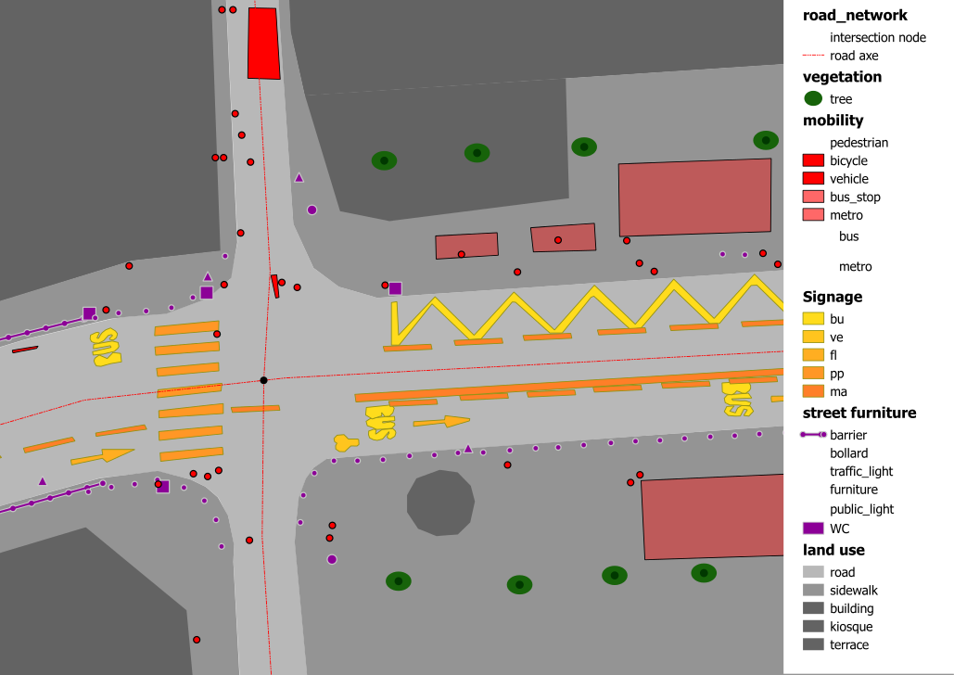
State of the art: modelling street is hard
complex / traffic / organisation/ sensing

Slide 16
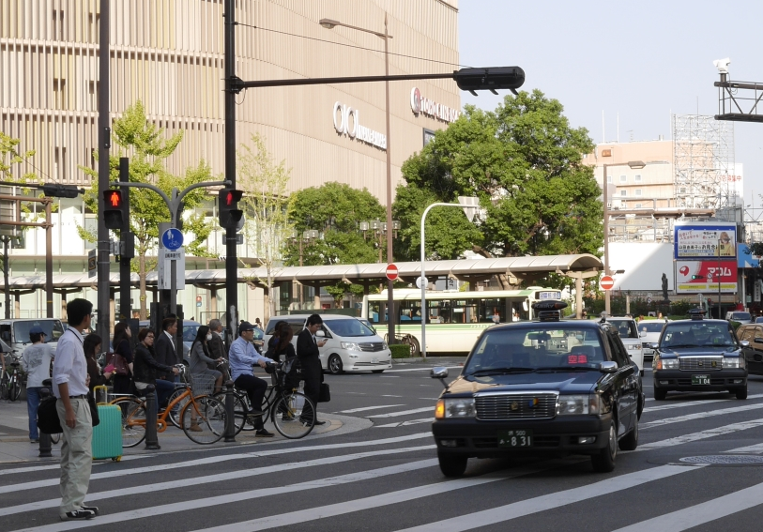
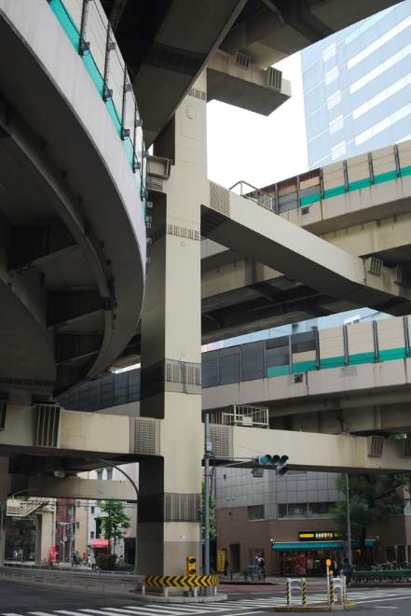
State of the art: modelling street is hard
complex / traffic / organisation/ sensing

Slide 17
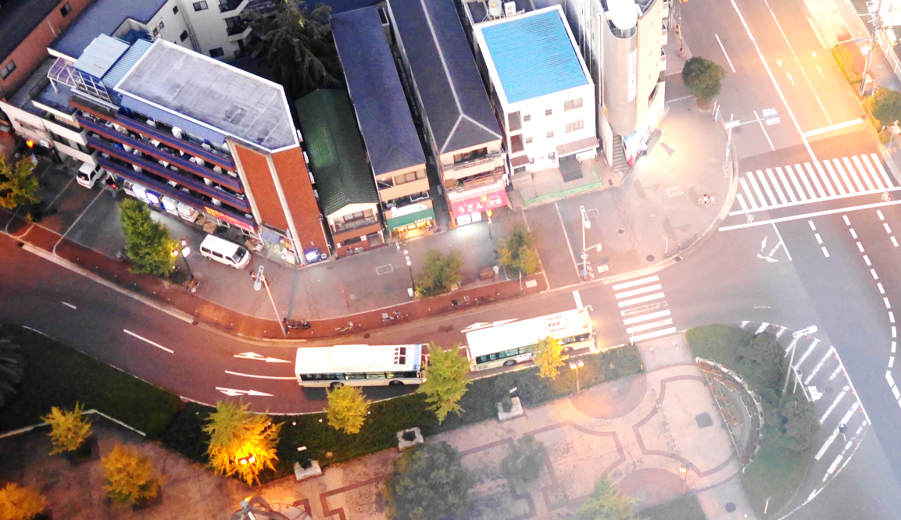
State of the art: modelling street is hard
complex / traffic / organisation/ sensing

Slide 18
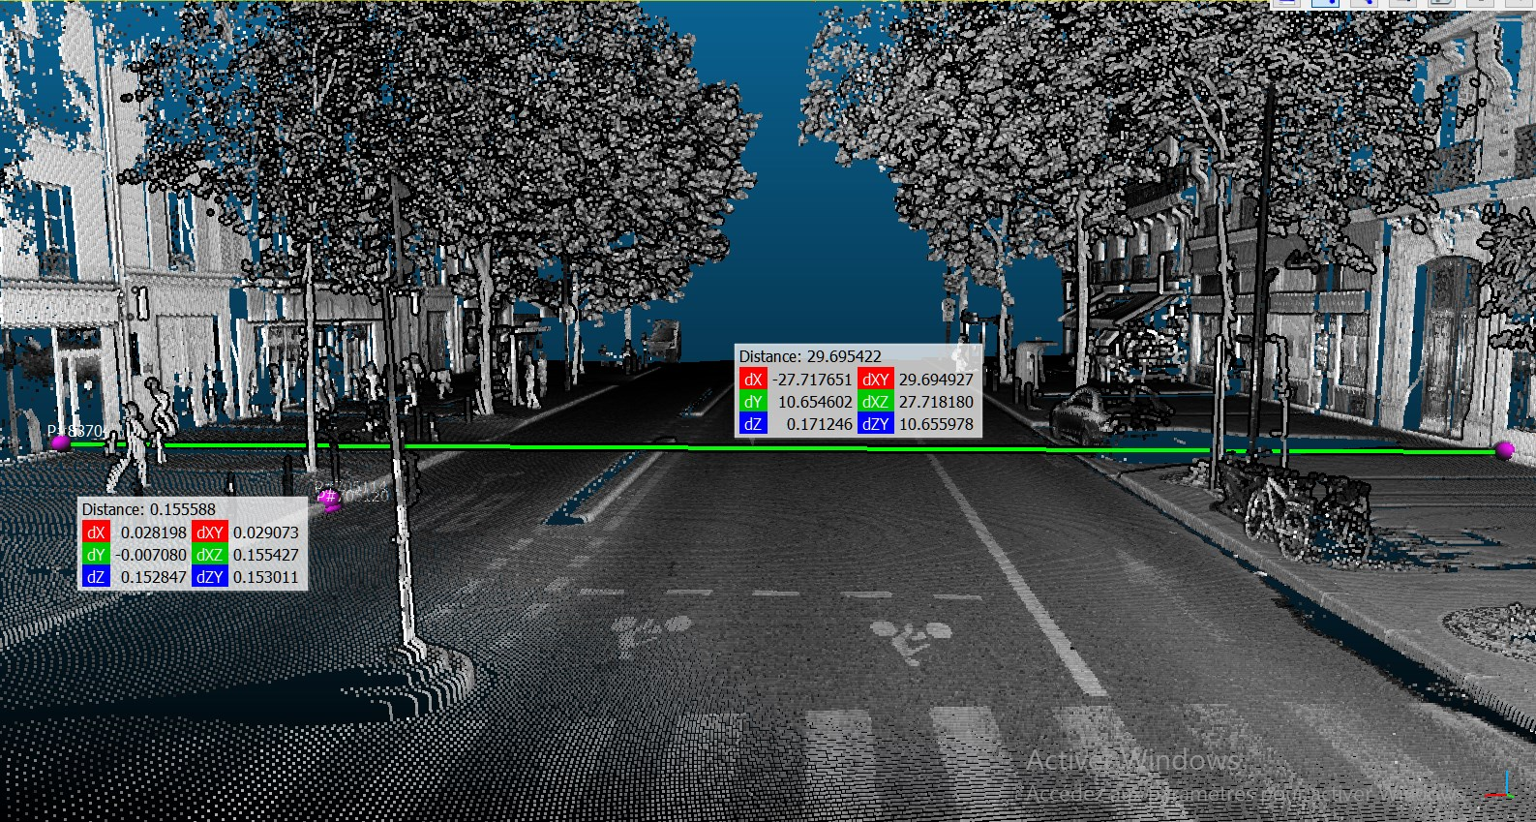
State of the art: modelling street is hard
complex / traffic / organisation/ sensing
Manual : millions of objects
Automatic :
high occlusion
Small details are essential (curb)

Slide 19
State of the art
Modelling street, why is it hard?
Existing methods

Slide 20
State of the art: Existing models
im
What should be modelled?
Street precise geometry (roadway/ sidewalk / …)
Street road as part of whole network (= traffic info)
Street organisation
Street objects
Street objects relations
Material/visual aspects …
im

Slide 21
State of the art: Existing models
Guo2015
Montoya-Zegarra2014
Boyko2011
Serna2015
Gallin2011
Wilkie2012
Chen2008
Kuntzsch2015
CityGML
Road XML
Wang2015
Open Drive
Despine2011

Slide 22
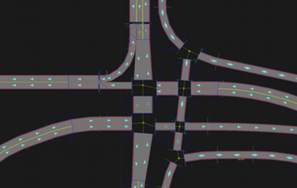
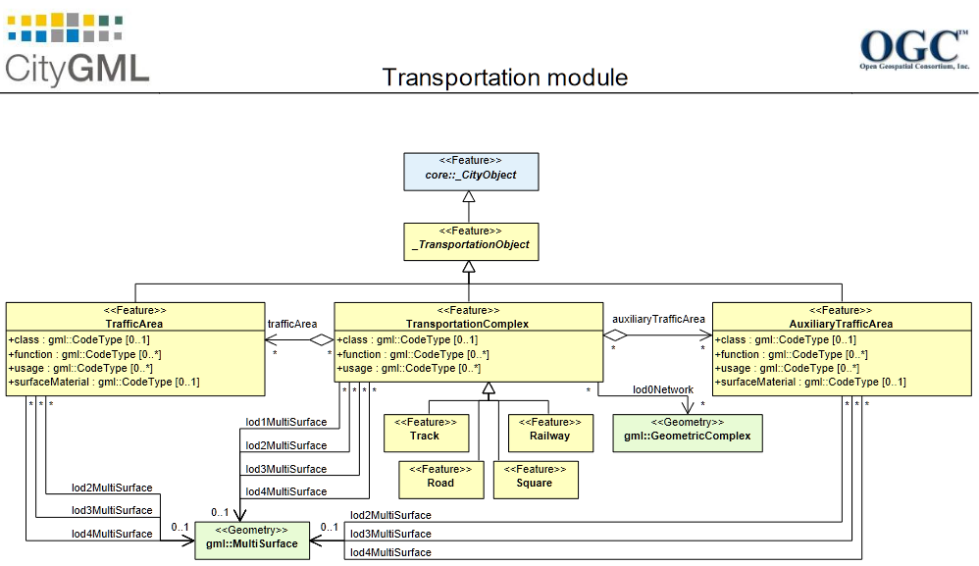
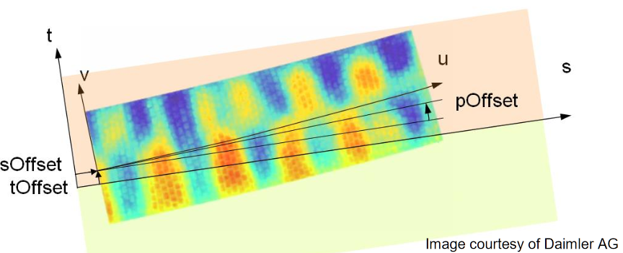
State of the art: Existing models
System / GIS / Simulation / Procedural / Data-driven
Whole system modelling
City GML : for city, but contains a road module
Road XML : oriented for traffic simulation
Open Drive : high geometric details

Slide 23
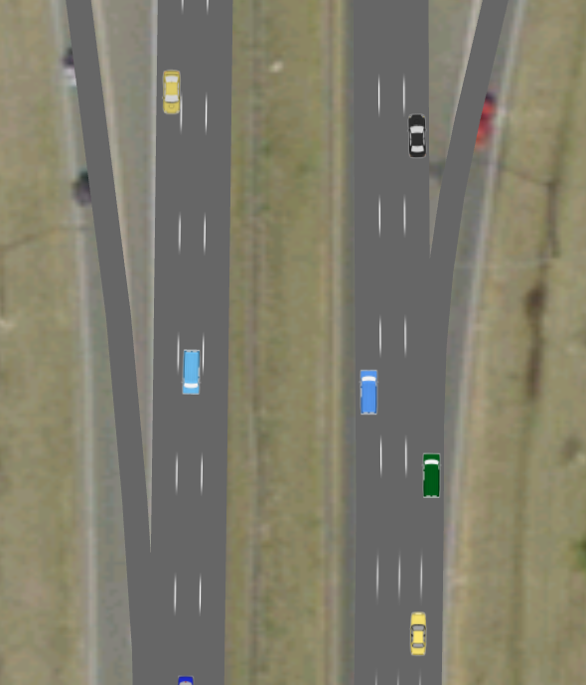
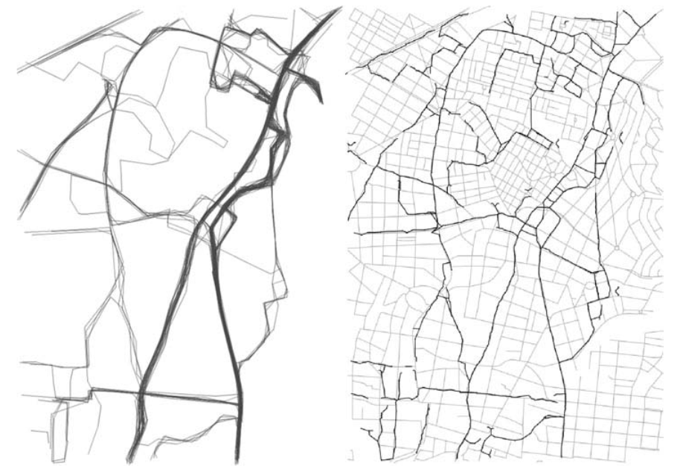
State of the art: Existing models
System / GIS / Simulation / Procedural / Data-driven
Wilkie2012
GIS-based modelling
Kuntzsch2015
Turning radius, network of lane, simulation
Street segment KDE, intersection with RJ-MCMC

Slide 24
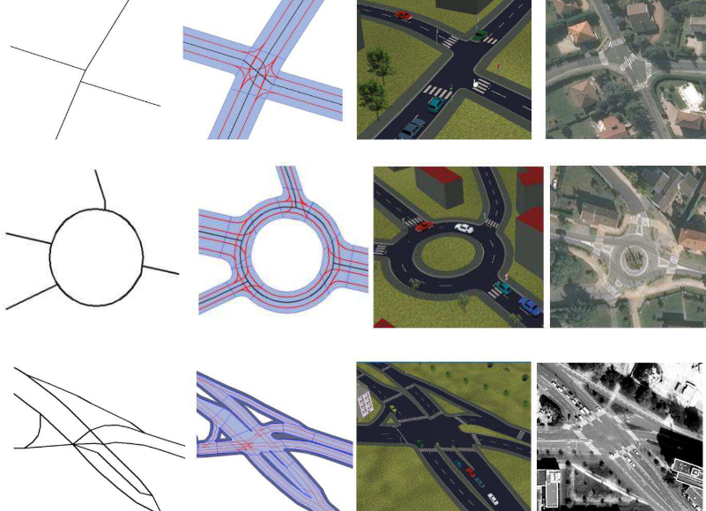
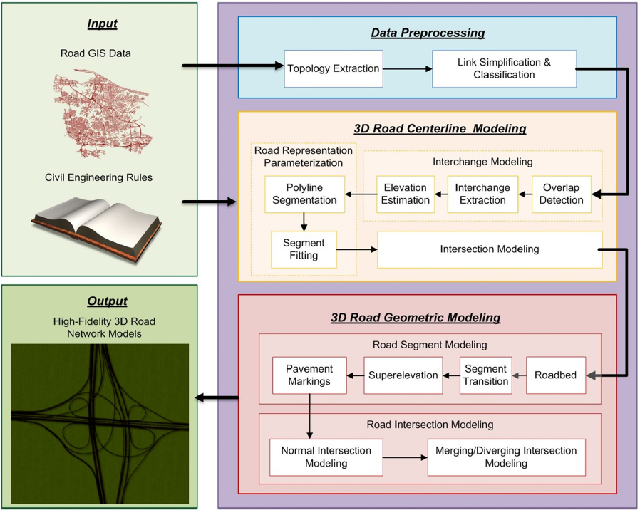
State of the art: Existing models
System / GIS / Simulation / Procedural / Data-driven
Simulation-based modelling
Despine2011
Wang2015
Segment of road parametrisation, intersection…
Network from data, guessing lane, intersection by continuity, 3D generation

Slide 25
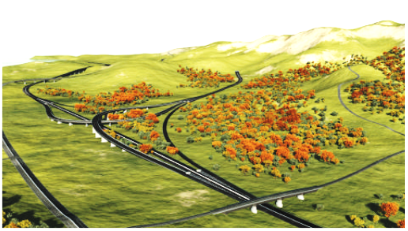
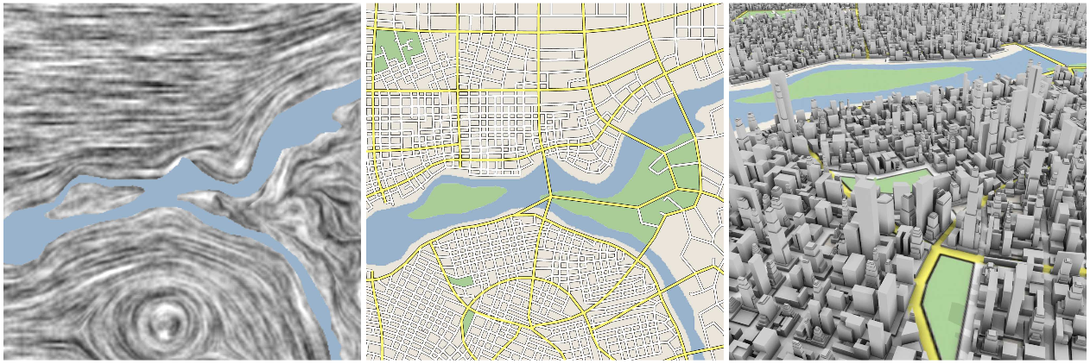
State of the art: Existing models
System / GIS / Simulation / Procedural / Data-driven
Procedural modelling
Gallin2011
Chen2008
Terrain, graph : shortest path and merging, procedural generation
Tensor, stream line, grammar

Slide 26

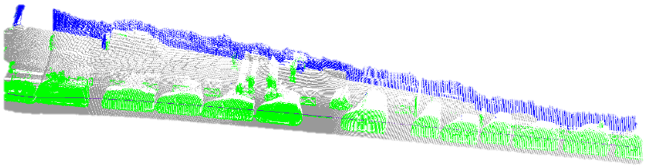
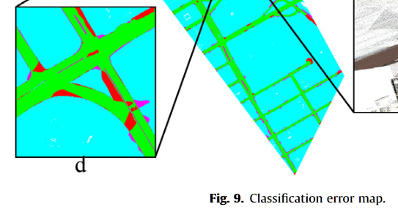
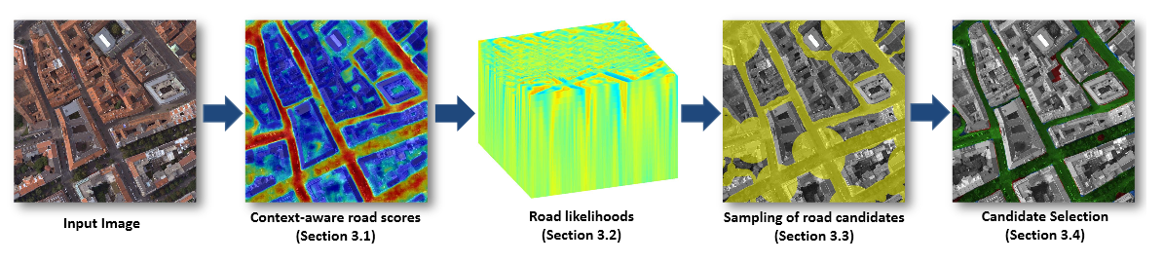
State of the art: Existing models
System / GIS / Simulation / Procedural / Data-driven
Data-driven modelling
From image/lidar
Guo2015
Serna2015
Cascade random forest
Extraction, raster, template matching
Boyko2011
Montoya-Zegarra2014
Fitting + active contour
Classif + Context + CRF

Slide 27
State of the art: Existing models
System / GIS / Simulation / Procedural / Data-driven
Data-driven modelling
From aerial imags
Todo : detailed ref for remote sensing from images

Slide 28
StreetGen : generate streets
Design Principle
Kinematic hypothesis
Road surface
Traffic support
Street objects

Slide 29
StreetGen : design principle
To Design = to compromise
Goals?
Model streets of whole Paris (scale, robustness)
Work with limited GIS data (best guess)
Model used for various outputs (analysis/ 3D visu / traffic simulation...)
Our approach:
Limited data : based on road axis, use simple hypothesis
Scaling & Coherent structured model : use a RDBMS

Slide 30
StreetGen : design principle
Not a model for all streets, but a model for most of streets
3 observations on streets
Structured by street axis
2 type of parts : morphologically constant or varying

Slide 31
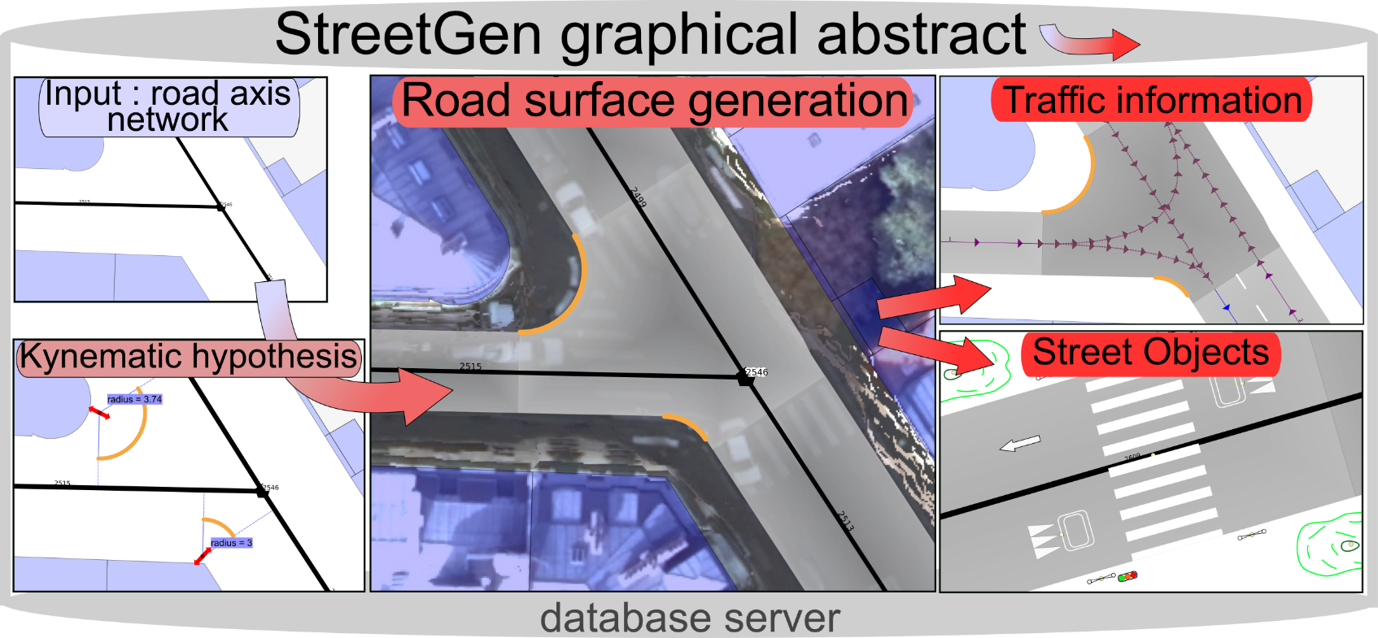
StreetGen : generate streets
StreetGen : graphical abstract

Slide 32
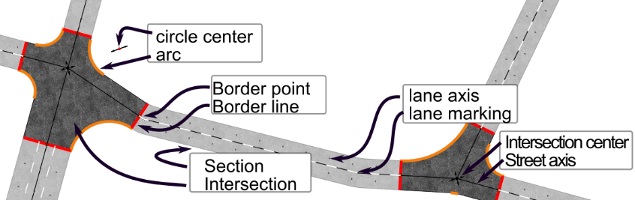
StreetGen : design principle
StreetGen road model

Slide 33





StreetGen : design principle
How to deal with several users? Use a RDBMS !
Read file , process, write results in a file
RDBMS : made to abstract & secure data
UPDATE MODELING (SYNC)
Input data
User input
Ask computing on/ edit
StreetGen
Road modeling
Visualize

Slide 34
StreetGen : design principle

Slide 35
StreetGen : design principle

Slide 36
StreetGen : generate streets
Design Principle
Kinematic hypothesis
Road surface
Traffic support
Street objects

Slide 37
StreetGen : Kinematic hypothesis

Slide 38
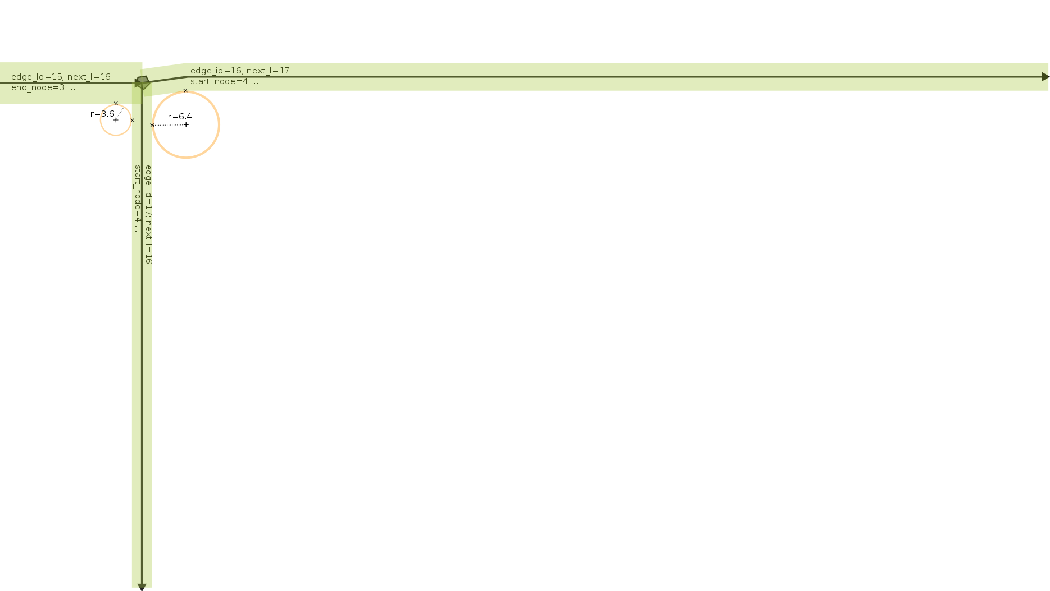


StreetGen : Kinematic hypothesis
Kinematic hypothesis
width
~ Road type
→
~ speed
→
~ radius
3m
9m
Or some actual speed database

Slide 39
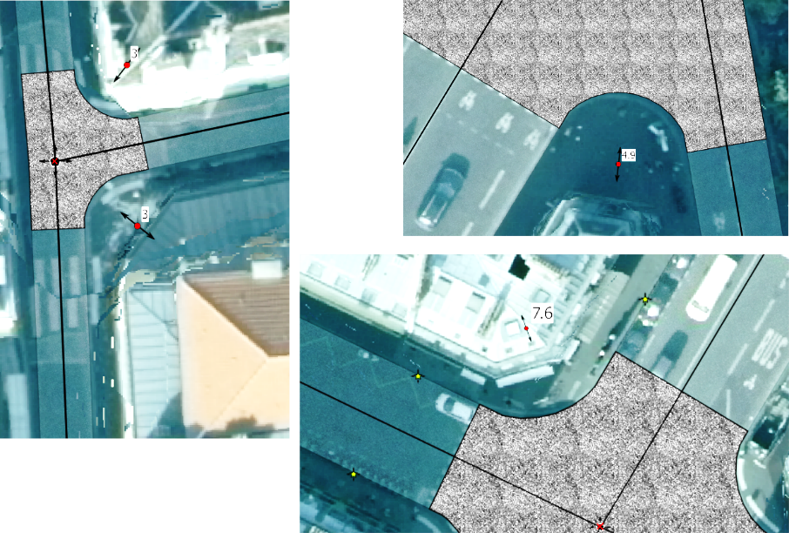
StreetGen : Kinematic hypothesis
Various radius in Paris

Slide 40
StreetGen : Kinematic hypothesis

Slide 41
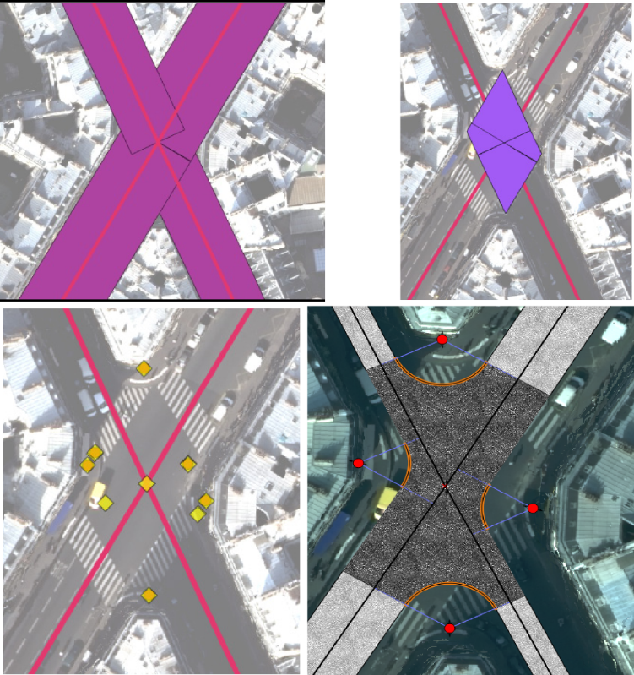
StreetGen : Kinematic hypothesis
t

Slide 42
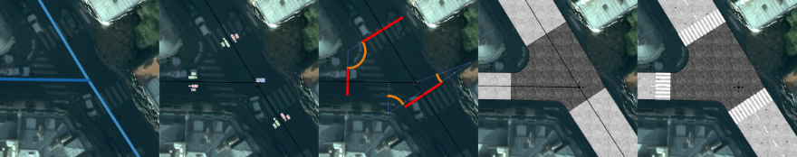
StreetGen : generate streets
Design Principle
Kinematic hypothesis
Road surface
Traffic support
Street objects

Slide 43
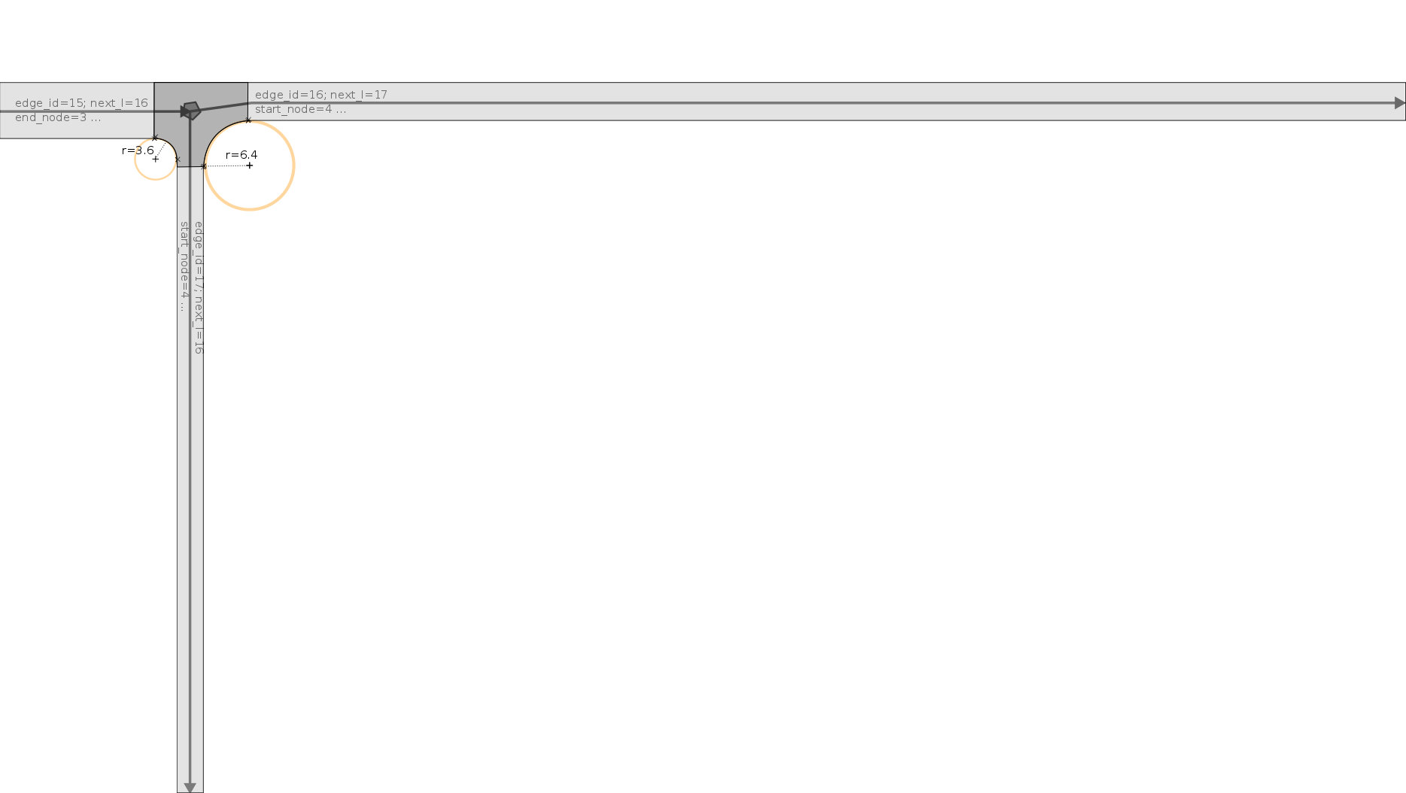
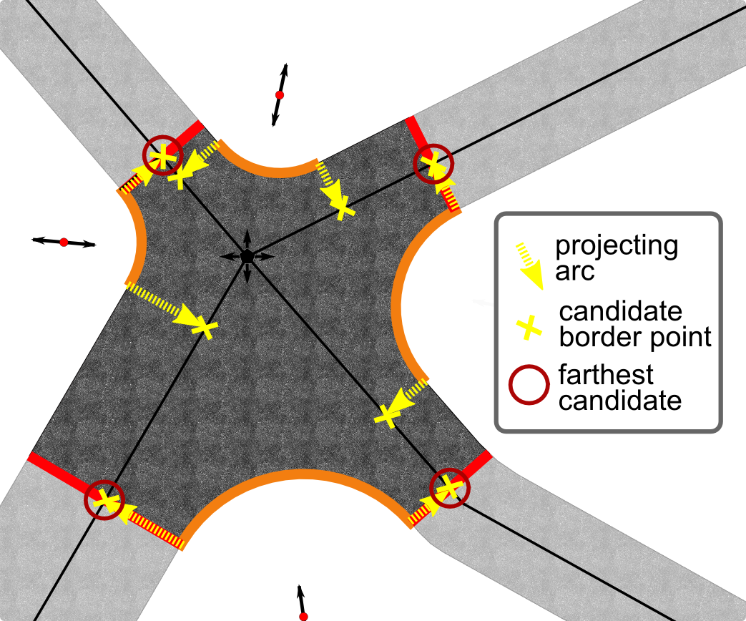
StreetGen : Road surface
Find intersection limit :
Project circle centers
Farthest per axis

Slide 44
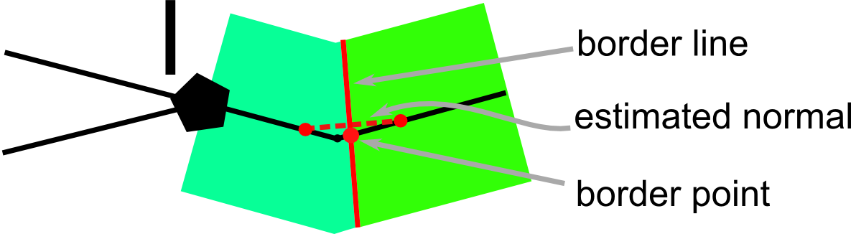
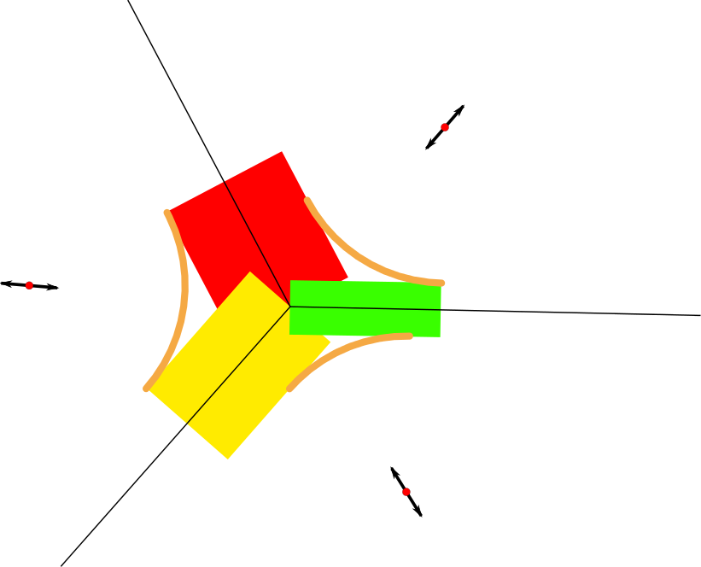
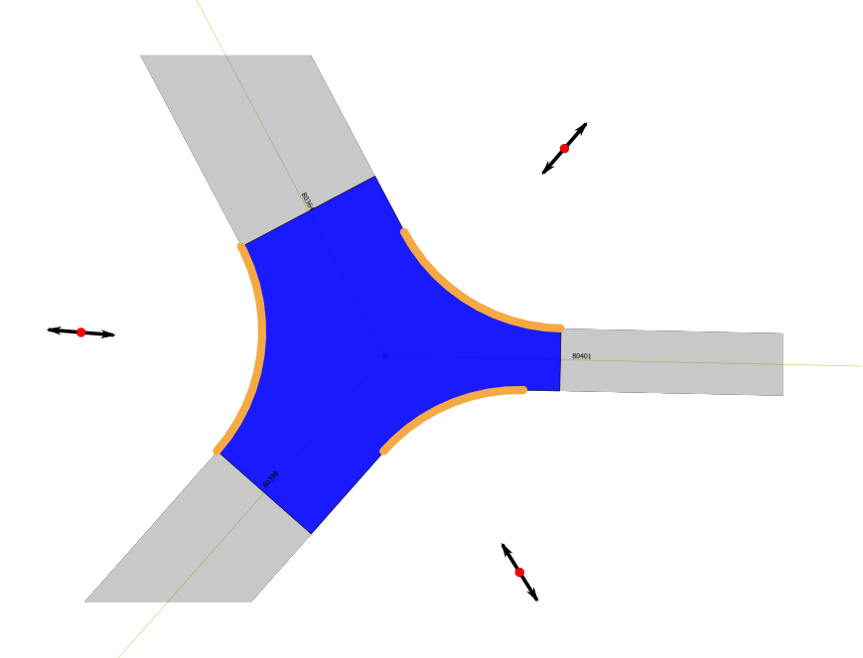
StreetGen : Road surface
Create Intersection surface :
By geometric operation

Slide 45
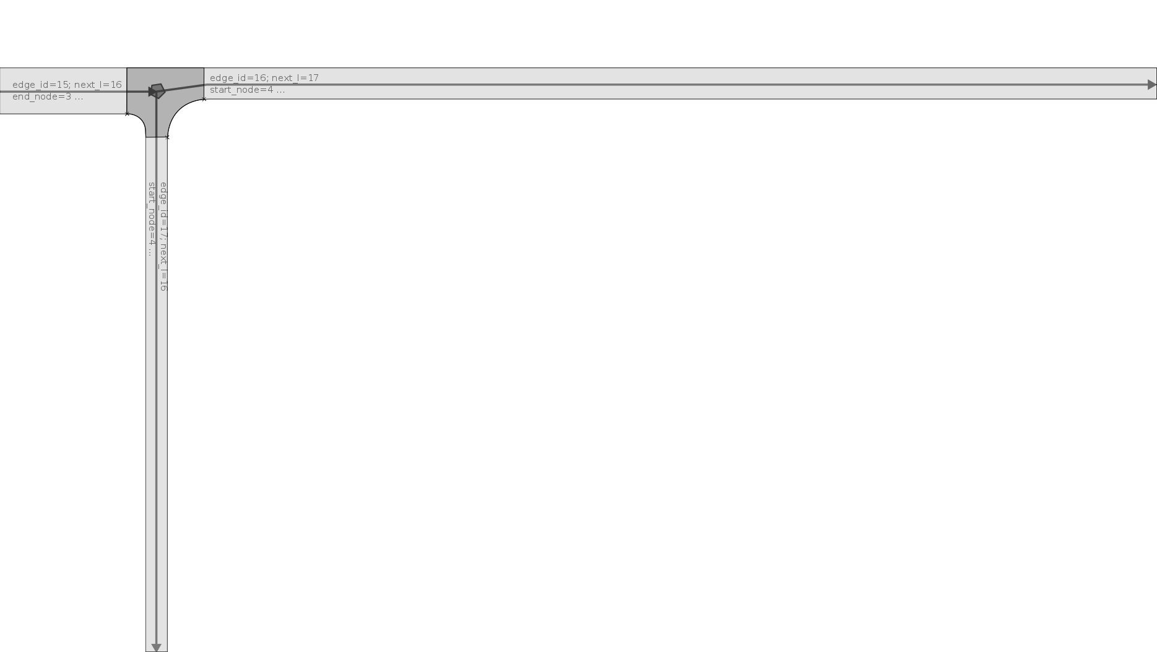
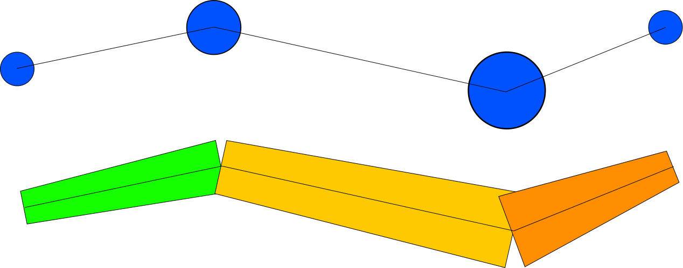
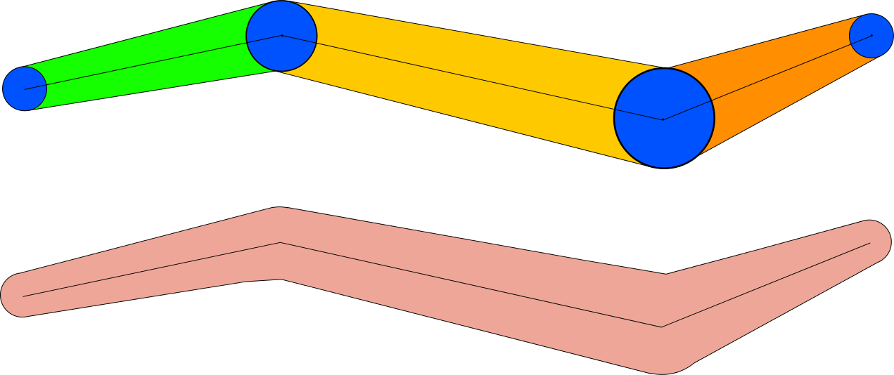
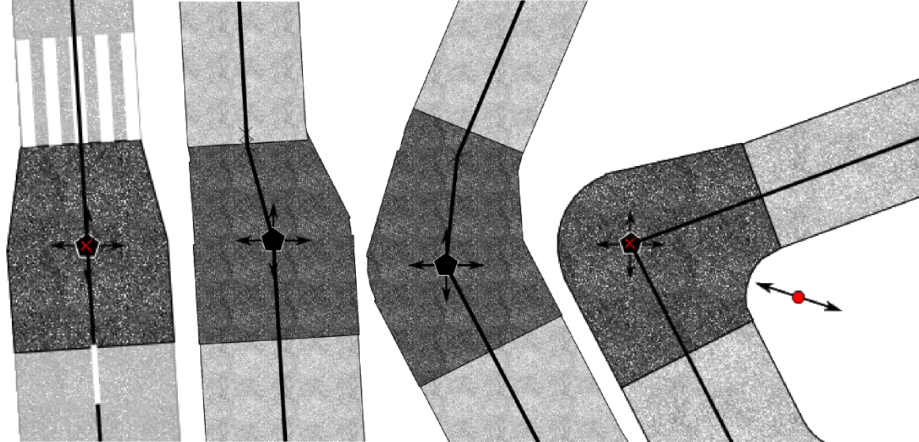
StreetGen : Road surface
Special intersection:
Variable buffer
No other parameter for road width reduction control

Slide 46
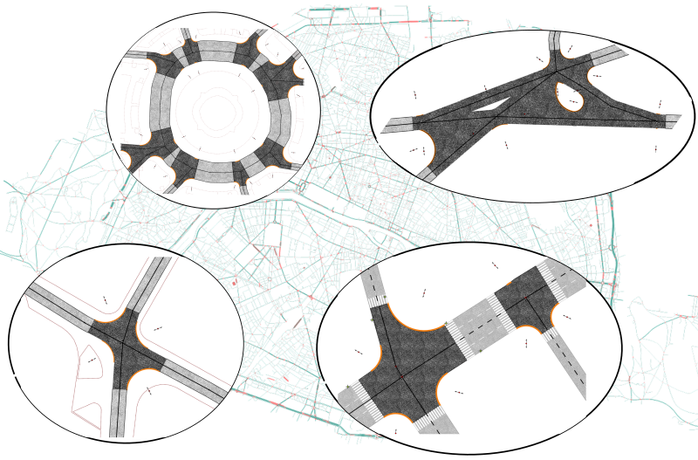
StreetGen : Road surface
results

Slide 47
StreetGen : Road surface

Slide 48
StreetGen : generate streets
Design Principle
Kinematic hypothesis
Road surface
Traffic support
Street objects

Slide 49
StreetGen : Traffic Support
For traffic simulation:
Lanes
Possible trajectories in interconnections.
Traffic simulation requires much more
Average speed
Type of intersection (roundabout/traffic light)
Etc …

Slide 50
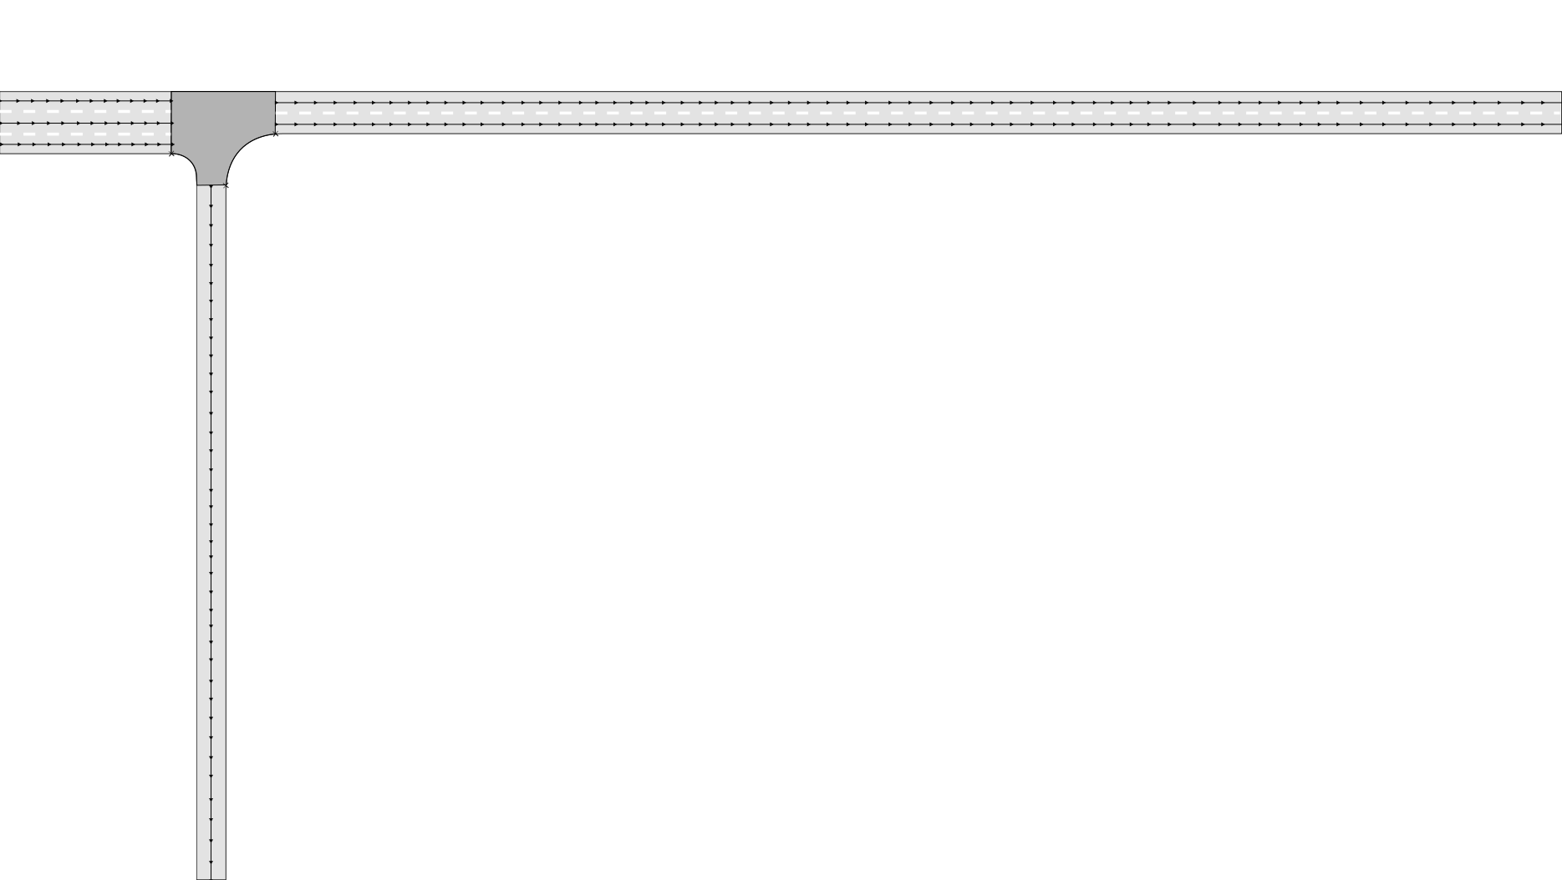
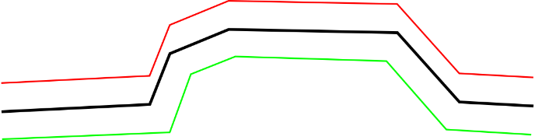
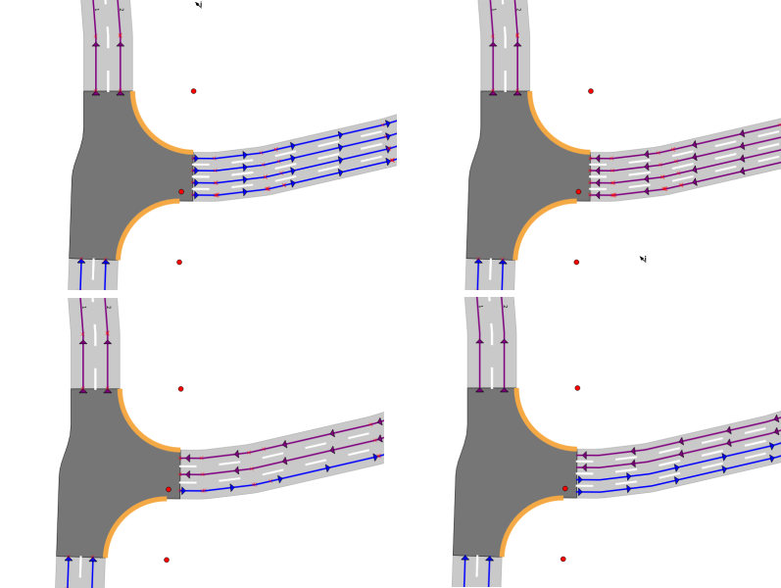
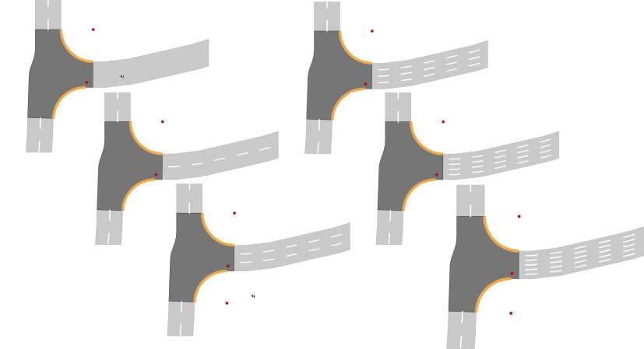
StreetGen : Traffic Support
Lane based on road axis : but not translation

Slide 51
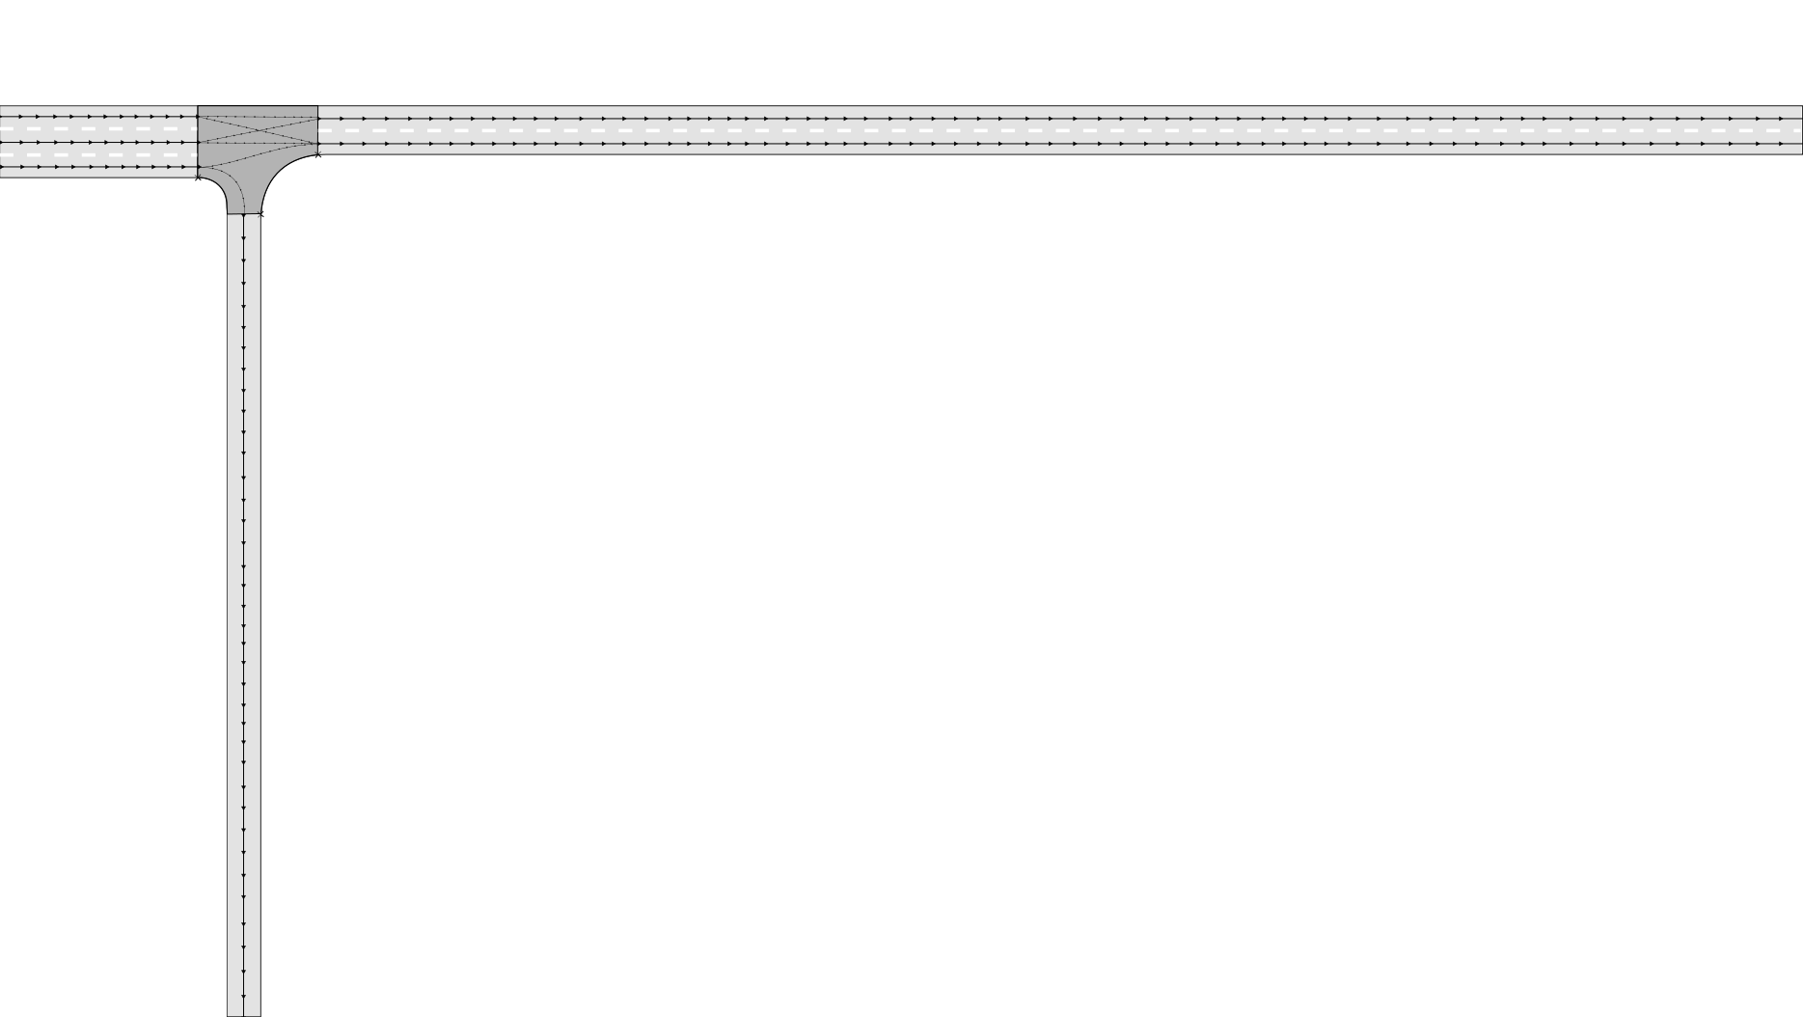
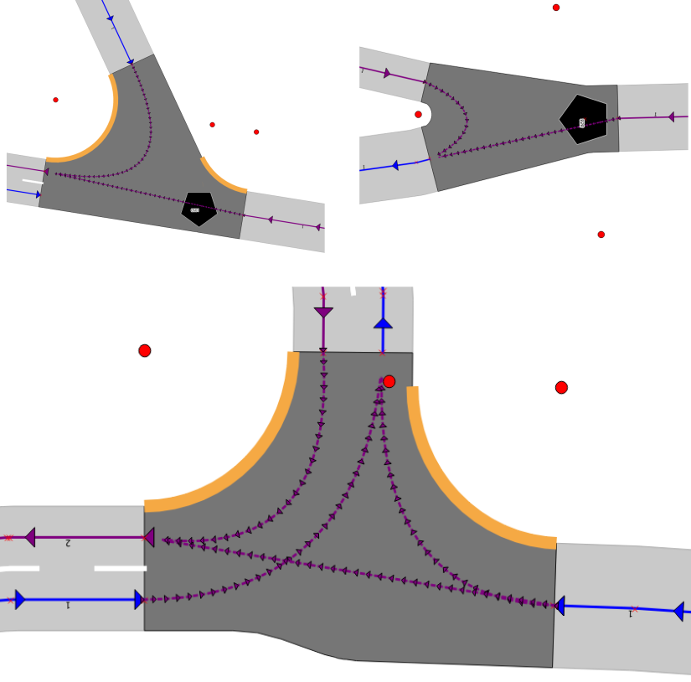
StreetGen : Traffic Support
Intersection trajectory : Bezier curves:
Not accurate (cinematically), but easy to create and edit
Involves center of intersection in special cases
Direction coherent with lane direction

Slide 52
StreetGen : generate streets
Design Principle
Kinematic hypothesis
Road surface
Traffic support
Street objects

Slide 53
StreetGen : street objects
Streets objects : incredibly varied
13k references on www.ArchiExpo
Norms : Instruction Interministérielle sur la signalisation routière : 1000 pages
…
Objects are in relation (hierarchical, spatial, semantic …)
Not many common points between all kind of street objects
Street objects are often spatially organized (position and orientation )relatively to the street axis
Im: random objects

Slide 54
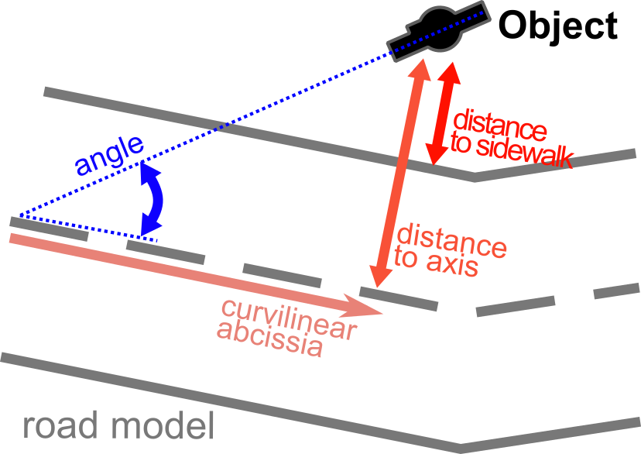
StreetGen : street objects
So we use generic objects
Positioned/oriented relatively to street axis

Slide 55
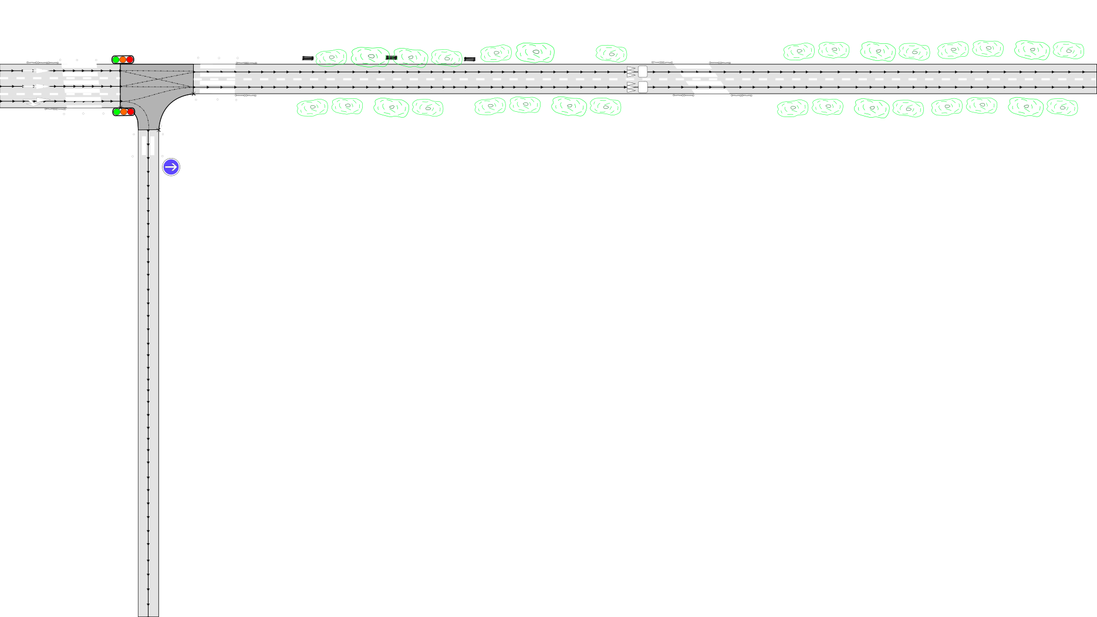
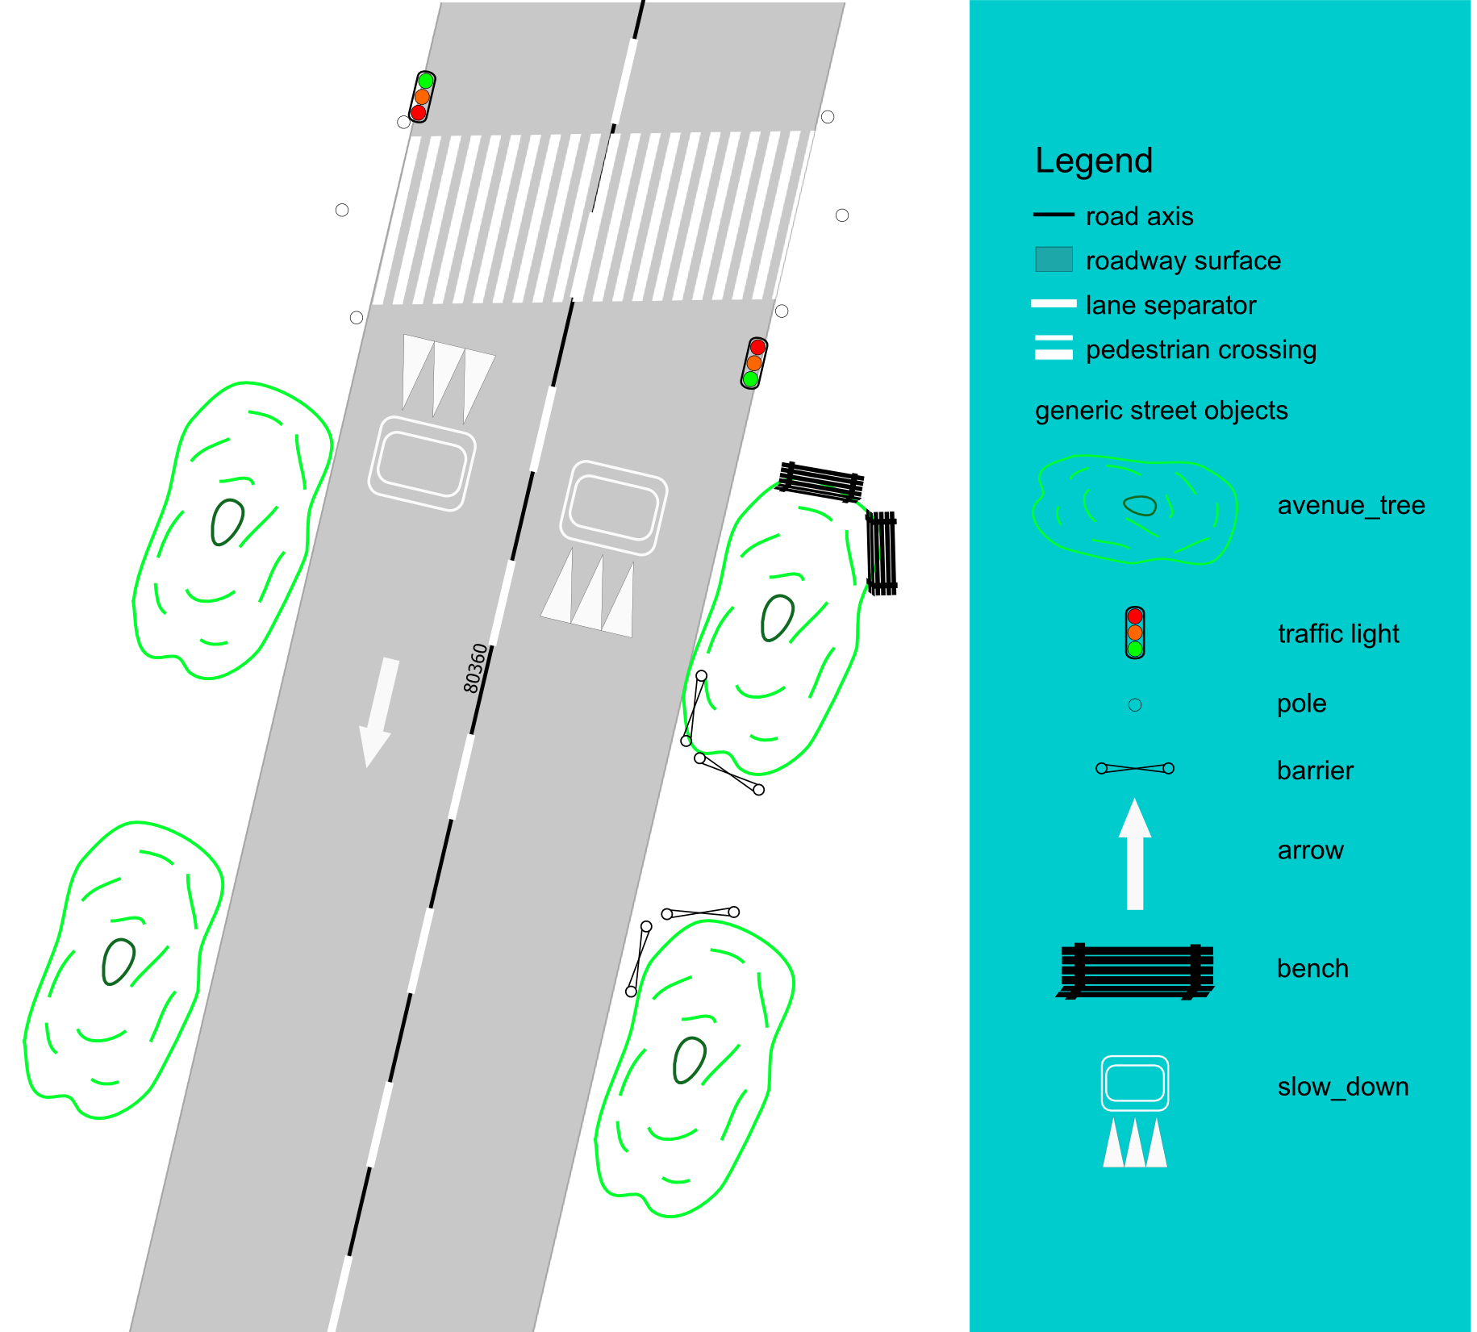
StreetGen : street objects
Objects are points with semantic
DBMS can support any relation (hierarchy, semantic…)

Slide 56
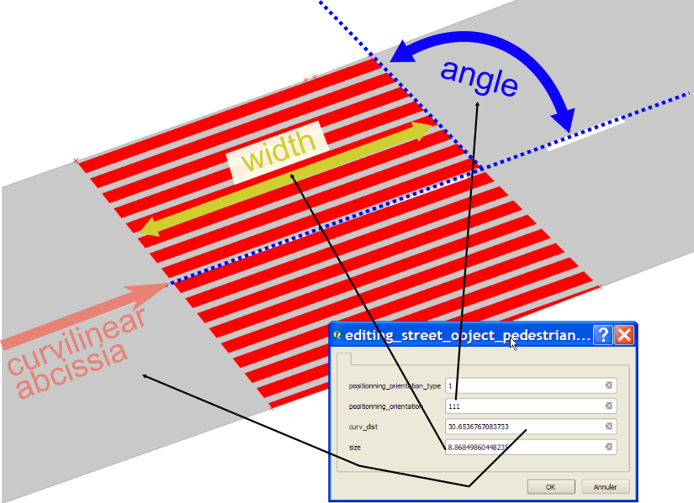
StreetGen : street objects
Also can also be surface (or polylines?) :
Pedestrian crossing for instance

Slide 57
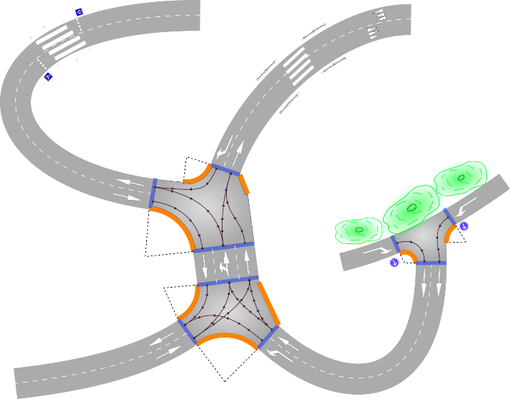
StreetGen : street objects
Whole Paris in 10 min.
Tested for simulation (SimuVia)
Tested for 3D visu (Thales NeoDBGS)
Tested to model other cities (West Africa)
Tested to model airport runway

Slide 58
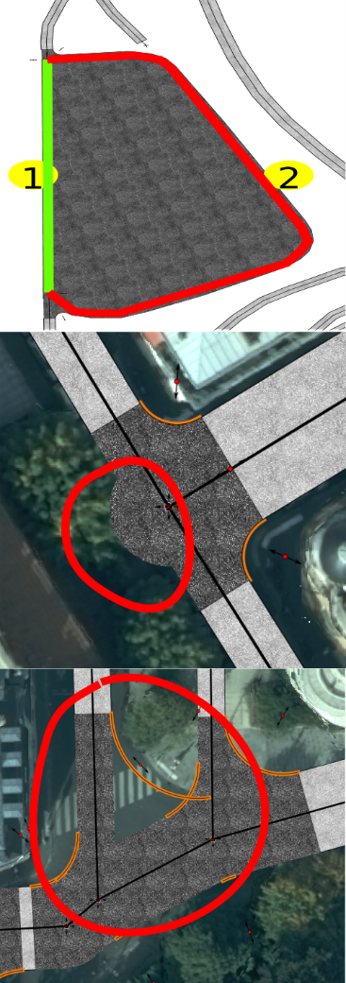
StreetGen : street objects
Of course, lot of limitations
Street model:
Not enough for some street
Radius seems to be historical rather than related to speed
Technical
Precision issues
Objects
Lack linear objects

Slide 59
StreetGen : editing streets (in-base)
In-base interaction Principle
Edit road model
Edit traffic
Edit objects

Slide 60
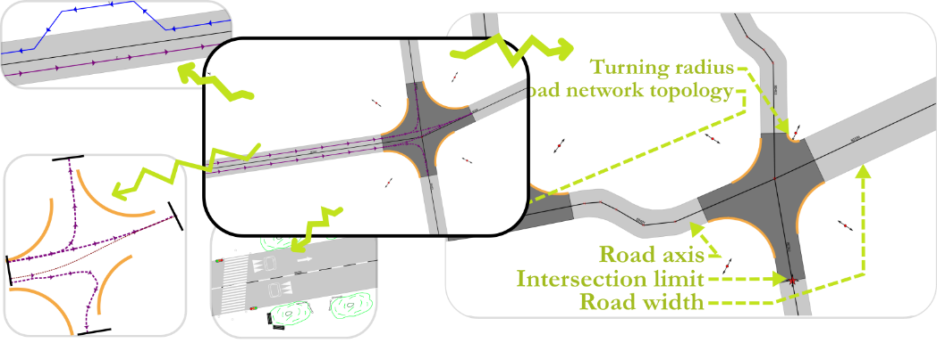
StreetGen : street objects
How to edit street model easily?

Slide 61
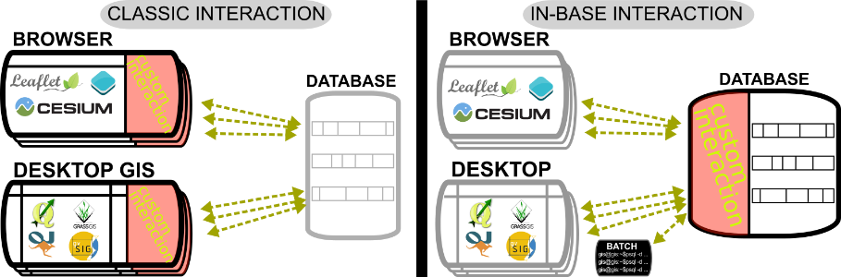
StreetGen : street objects
Fact : Graphical User Interface (GUI) → hard
Many GUI for many tools (web/desktop/…)
Need to create plugins/interfaces/…
Use existing tools !
GIS tools can already edit vector and attributes
specific interactions are in base

Slide 62

StreetGen : street objects
example:
In GIS software
In base

Slide 63

StreetGen : street objects
In-base interaction are generic and powerful
Design pattern to help use it for other applications

Slide 64





StreetGen : street objects
All StreetGen street model can be edited concurrently
Road axis/ width
Radius
Lane
Interconnection
objects

Slide 65


StreetGen : street objects
Multi-user editing can be facilitated
“Interactive Map Tracking” QGIS plugin with Lionel Atty

Slide 66

StreetGen : street objects
Results:
Interaction are fast enough to be interactive
Video
https://youtu.be/fQZoEfUcNHA

Slide 67

StreetGen : street objects
Several Limitations
limited to straightforward interaction (guessing user action is easy)
Old school : Hard to develop/test/maintain
one transaction → should be short
Objects: relative positioning may be ambiguous

Slide 68
Automating street modelling
Inverse procedural modelling concept
Fitting model to real streets

Slide 69








StreetGen : Inverse procedural modelling
Inverse Problem:
Procedural model
Model = C(3.2,2.1,1.5)
fit
→
+
Image : Three-dimensional modelling and visualisation of vegetation for landscape simulation

Slide 70


StreetGen : Inverse procedural modelling
Wan2012
Fit a generic procedural model to a specific situation
Specific situation?
→ We need data!
Talton2011

Slide 71

Abstract
Inverse
Procedural Street Modelling

Slide 72

StreetGen : Inverse procedural modelling
What type of data for streets?
Precise
Good coverage
Frequent
Aerial image?
Good coverage
Low 3D precision

Slide 73
StreetGen : Inverse procedural modelling
IGN dedicated mobile mapping: Stereopolis
Cameras
Lidar

Slide 74

StreetGen : Inverse procedural modelling
Street view:
Good coverage

Slide 75

StreetGen : Inverse procedural modelling
Lidar: 3D point clouds
precise 3D

Slide 76

Automating street modelling
Inverse procedural modelling concept
Fitting model to real streets

Slide 77

Inverse Procedural modelling: method
Initial road model + observation → optimisation → fit road model

Slide 78

Inverse Procedural modelling: method
Initial road model + observation → observation affects part of road model→ fit road model
Mecanical Analogy : observations pull/push road model= forces

Slide 79


Inverse Procedural modelling: observations
Observation = clues about roadway

Slide 80

Inverse Procedural modelling: observations
Observation = clues about roadway

Slide 81


Inverse Procedural modelling: forces
Each street object type has an expected position:
IN/OUT + BORDER_IN/BORDER_OUT (dist)
Ex :
Pedestrian crossing marking : BORDER_IN (0.2 m)
No parking markings : BORDER_OUT (0.1m)
road markings : IN
…

Slide 82

Inverse Procedural modelling: forces
Each type of street object expected position is defined in a table

Slide 83

Inverse Procedural modelling: forces
Observations generate forces on road axis/width
Each street object type has an expected position:
IN/OUT + BORDER_IN/BORDER_OUT + dist

Slide 84

Inverse Procedural modelling: forces
So if we sum up forces from observations :

Slide 85

Inverse Procedural modelling: forces
Others forces: resisting changes : express confidence in initial road model

Slide 86


Inverse Procedural modelling : matching
Observations generate force on road axis/width, But first :
Observation ←matching→ road axis:
Closest road surface

Slide 87

Inverse Procedural modelling: matching
In intersection : can’t use observations:
We would need to optimise full road surface model

Slide 88
Inverse Procedural modelling: matching

Slide 89

Inverse Procedural modelling: experiment
Optimisation = Non-linear least square
→ no guarantee to find the global optimal solution, robust, very fast
Open source : Ceres solver
Areas of experiment:

Slide 90


Inverse Procedural modelling : small area

Slide 91

Inverse Procedural modelling : small area

Slide 92

Inverse Procedural modelling : small area

Slide 93


Inverse Procedural modelling : small area

Slide 94


Inverse Procedural modelling : small area

Slide 95
Inverse Procedural modelling : small area
Quantitative evaluation:
Using Only kerb observation:
Median dist to Open Data Paris :
from 1.8m → 0.4m (with user input: 0.34m )
It’s much better, robust and fast (50ms)!

Slide 96

Inverse Procedural modelling : sensing area
Whole sensing area:
Results:
Looks ok, but,

Slide 97

Inverse Procedural modelling : sensing area
Yellow circle are proportional to error:
Most of the cases :
Not enough observations!
Yet, Median dist to ODParis : from 1.5m → 0.6m
→ it’s still way better

Slide 98
Inverse Procedural modelling : sensing area

Slide 99

Inverse Procedural modelling : Paris area
Whole Paris with Open Data Paris (Ideal data) : works but :
topology is broken at few points
Few enough to manually correct
from 1.5m → 0.1m

Slide 100
Inverse Procedural modelling: Paris area

Slide 101
Inverse Procedural modelling: Streetgen on optim
Once simple road model is optimised, we can generate streets with StreetGen

Slide 102

Inverse Procedural modelling: Streetgen on optim
Streetgen after optimisation

Slide 103

Inverse Procedural modelling: Streetgen on optim
Traffic information is generated (but has not been optimised)

Slide 104

Inverse Procedural modelling: error sources
Residual errors sources

Slide 105
Inverse Procedural modelling: Limitations
(Many) Limitations
Only optimising a simplified road model (no radius)
Road model is too simple
Must choose between trusting initial model and trusting observations
Lacking regularisation forces for width (propagation)

Slide 106
Data for observations: Point Cloud Server
Short introduction to Lidar
Point Cloud Server

Slide 107

StreetGen : Inverse procedural modelling
Demo Live mobile mapping Lidar (Velodyne)

Slide 108
Data for observations: Point Cloud Server
Short introduction to Lidar
Point Cloud Server

Slide 109



Point Cloud Server
Point Cloud Server : manage massive amounts of geospatial point clouds in a database.
Many type of geospatial point clouds
Terrestrial LIDAR
Medical
imaging
Aerial LIDAR
Stereovision

Slide 110
Point Cloud Server: Problems
Problem:
Massive data → need
Sharing
Filtering
Efficient I/O
Compression
Very specific for various purposes
(many tools/formats/usage)
Point cloud != only processing
need to manage the entire pipeline
need meta data / contextual information
cross use with other data

Slide 111
Point Cloud Server: State of the art
Otepka et al., 2013
File-based
Simple, no concurrency
Can’t do much with points
DBMS (point storing)
Powerfull
Can’t scale
NoSQL
Scale well
Specific and tailored
Cloud
Ultimate scaling
Theoretical problem with indexing
DBMS (group of points storing)
All inclusive
Points need to be group-able
Rieg et al., 2014
van Oosterom et al., 2015
Todo : simplify, images
Managing billions of nD-points : difficult !
Greyhound
≠
Managing millions of groups of points: easy!

Slide 112

Point Cloud Server: Method
Idea:
PCS = a … server !
Point Cloud Server
File system
Many interfaces
possible
Abstraction
safe
RDBMS

Slide 113

Point Cloud Server: Method
Workflow

Slide 114



Point Cloud Server: Method
Main idea about storing
1 point =
GPS_time (s) X (m) Y(m) Z(m) reflectance (…. )
54160.295 2068.230 20690.025 45.934 -9.4497 (…. )
1 row = 1 point
Analogy : Pixels
1 row = N points
Analogy : Image
Color = group
Billions points
Million groups
Usage : do we really need to get points 1 by 1?

Slide 115


Point Cloud Server: Loading/Exporting
Loading/exporting points into the PCS:
2 flavors : how much does the server work?

Slide 116


Point Cloud Server: Loading/Exporting
Paris
Terrestrial lidar
2.15 B points
750 ply files
42 linear km
21 attributes
Typical resolution: 1 cm

Slide 117

Point Cloud Server: Loading/Exporting
Paris loading speed: 75k pts/s writing : 200k pts/s
Not far from actual sensing speed
Could be faster (Vanoosterom2015)
We load point clouds, but how are they stored?

Slide 118

Point Cloud Server: generalisation
Group of points (aka patch) generalisation
Generalisation = abstraction

Slide 119
Point Cloud Server: generalisation
Other generalisation
Essential : abstracting the data = more abstract usage
Ex : points within flat neighborhood vertical VS points in a wall
Top view in QGIS

Slide 120


Point Cloud Server: processing
More generalisation

Slide 121

Point Cloud Server: filtering
With so much data:
Essential to access only a part of it : example
Patches that are
far from buildings
close to the intersection these 2 streets
aerial view color ≈ pedestrian crossing
close trajectory
with high point density

Slide 122






Point Cloud Server: filtering
Result : finding millions of points amongst billions :
100 ms if indexed !
Which points are inside the polygon?
Which patchs are inside the polygon?
Get points in these patches
Which points are inside the polygon?
points
Points in patch
?

Slide 123



Point Cloud Server: processing
Postgresql: easy to add in-base processing
C/Cpp → for performance
R/Python → for fast prototyping
Example :
Verticality descriptor
Unsupervised clustering
Plane & cylinder detection

Slide 124










Point Cloud Server: processing
Converting patch to raster
Cornerstone detection
Marking detection
Façade detection

Slide 125

Point Cloud Server: processing
classification

Slide 126

Point Cloud Server: processing
Patches can be used in a graph structure

Slide 127

Point Cloud Server: Level Of Detail
Level Of Detail (LOD):
Sometimes you don’t need all the points
12 Millions points, really?
User needs only a given Level Of Detail.

Slide 128

Point Cloud Server: Level Of Detail
Idea : implicit LOD
order the point by importance
Reading the points gradually increases the level of detail

Slide 129






Point Cloud Server: Level Of Detail
Example

Slide 130

Point Cloud Server: Level Of Detail
For visualization, LOD depends on distance to camera

Slide 131
Point Cloud Server: Level Of Detail
LOD enables point streaming
Mettre screen paul blottiere

Slide 132

Point Cloud Server: Level Of Detail
Also for classical GIS soft that can’t deal with too many points

Slide 133

Point Cloud Server: Level Of Detail
Limitations
Points have to be group-able
Our Loading/export could be much faster
Filtering is fast at patch level(O(ln(n))), not point level (O(n))
LOD : rely on ordering the points !
You have to use it
May be slow to build
For the moment, getting a part of the patch require to read it entirely

Slide 134
Conclusion
Summary
Limitations
Perspectives

Slide 135
Conclusion: Summary
From low information: generate best guess street model at Paris scale and edit it (multi-user, using many GIS software): StreetGen

Slide 136
Conclusion: Summary
Manage a massive amount of 3D points (from mobile mapping). Act as a service for usage/processing/visu: Point Cloud Server

Slide 137
Conclusion: Summary
Perform inverse procedural modelling by fitting a road model to various observations

Slide 138
Conclusion
Summary
Limitations
Perspectives

Slide 139
Conclusion: Limitations
Very simple street model: revolves around street axis.
Too simple?
Pedestrian street?
Based on topology → hard to maintain/scale/edit
Point Cloud Server :
Need several processing methods to extract observations
Coupling with street images missing
3D from images? Updating?
Objects are created/edited manually by user
Tedious, not much sense

Slide 140
Conclusion
Summary
Limitations
Perspectives

Slide 141
Conclusion: Perspectives
Only the beginning of inverse procedural street modelling.
Dealing with objects and road model simultaneously calls for much stronger modelling and optimisation methods
Object should be created by template/ pattern/ grammar/procedural functions!
Optimisation should be more powerfull (RJ-MCMC)

Slide 142
Conclusion: Perspectives
Since the beginning of the thesis :
Major trend in smart vehicle/autonomous cars
→maps no more required only by traditional data provider
→ maps potentially required by every (Billion) cars
Many methods on low level classification
Different cars with different hard → need a more abstract street model

Slide 143
Conclusion: Perspectives
“smart city” is trending
There is several cities in one city:
Saint Mandé entry roundabout .
Day : next to Lenotre: luxury caterer
Night: hookers
Time is essential (simulation/understanding)
4D street modelling ? (garbage/ café terrace/ parking behaviour)

Slide 144
Conclusion: Perspectives
Understanding city may be key to planning
To understand →study city history
Historical geodata
Hand drawn maps
Information needs to be extracted

Slide 145

Conclusion: Perspectives
Jacoubet, 1810-1836 :
road model with optimisation & Streetgen ?

Slide 146



Conclusion: Perspectives
Extract building number, buildings limits, street surface (B. Vallet)

Slide 147

Conclusion: Perspectives
procedural modelling candidate?
Turgot, 1734-1739 : isometric persp.

Slide 148

QUESTIONS
Thanks
Questions?

Slide 149
TODO
Conclusion need illustrations and splitting slides
Solve the todo

Slide 150
notes
Premiere page: logos en gros
Intro : trop fouilli, trop long
Point cloud server : mettre après optim
…

Slide 151
notes
- le besoin de mieux expliquer la démarche générale et de la rappeler avant chaque partie
- le besoin d'ajouter des contributions à la fin de chaque chapitre
- une réécriture des limitations pour être plus cohérentes
- le besoin de réduire l'information pour pouvoir passer plus de temps à expliquer certains schémas
- le besoin de fluidifier certaines transitions (notamment la transition nécessaire vu que le Point Cloud Server se retrouve à la fin)

Slide 152
appendix
annexe

Slide 153

StreetGen : Kinematic hypothesis
We have road axis, road width
How to compute circle center and arcs?
analytical computing (vector, angle) ?

